Slide 1
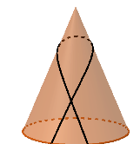
< 24h
< 24h
< 24h

